Slide 1

Soft Bank
Soft Bank

Slide 2

ginyard
Introduction
Aim of the Project
Objectives
System Requirements
Contents
UML Diagrams
Tech Stack
Project Modules & Project Screenshots

Slide 3

Soft Bank
Introduction
The Soft Bank Online Banking System is designed to offer customers a seamless, secure, and efficient platform to manage their banking needs over the internet. Traditional banking processes often require customers to visit a branch for tasks such as checking balances, transferring funds, and updating personal details. Soft Bank’s Online Banking System automates these functions, allowing users to access their accounts anytime, anywhere, using their computers or mobile devices. With features such as balance inquiry, funds transfer via NEFT and UPI, and the ability to update personal information, this system enhances user convenience and banking flexibility. Additionally, it focuses on providing a secure environment for all transactions, clear communication regarding fees, and a user-friendly interface, ensuring a smooth banking experience. The primary goal of the Soft Bank Online Banking System is to offer fast, secure, and accessible banking services while ensuring customer satisfaction through streamlined processes.

Slide 4
Soft Bank
Aim of the Project
Our aim is to provide a convenient and secure platform for users to manage their banking activities over the internet. This system automates various banking tasks such as balance inquiry, fund transfers, profile updates, and account statement generation, making banking services accessible anytime and anywhere. Additionally, it ensures the security of user data and transactions, while offering easy account management, fund transfer options, and personalized settings for a seamless banking experience.

Slide 5


Soft Bank
Objectives
Offer Seamless and Convenient Access
Provide Instant and Secure Transactions
User-Friendly Interface
Promote Safe and Secure Banking
Enable 24/7 Access

Slide 6

Soft Bank
System Requirements
Java - 17
Angular - 18
Eclipse IDE

Slide 7
Soft Bank
Tech Stacks
Spring Boot
HTML 5
Mockito
Angular
CSS
JUnit
Micro-services
Bootstrap
MySQL

Slide 8

Soft Bank
UML DIAGRAMS

Slide 9
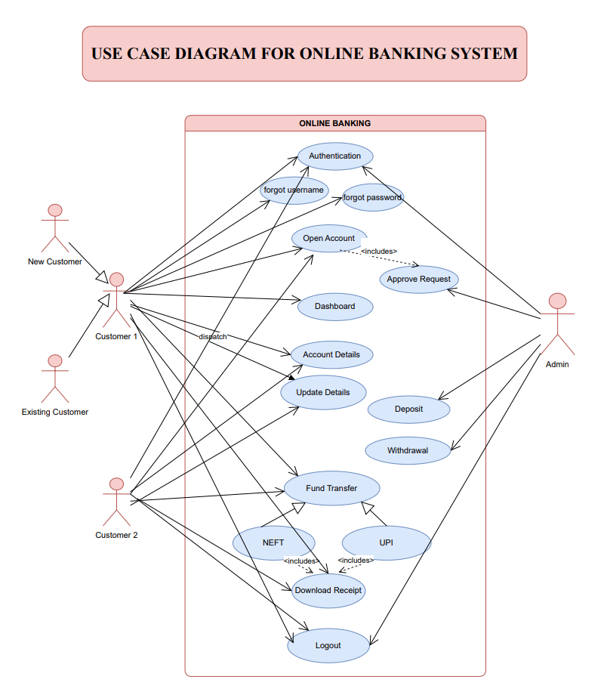
Soft Bank

Slide 10
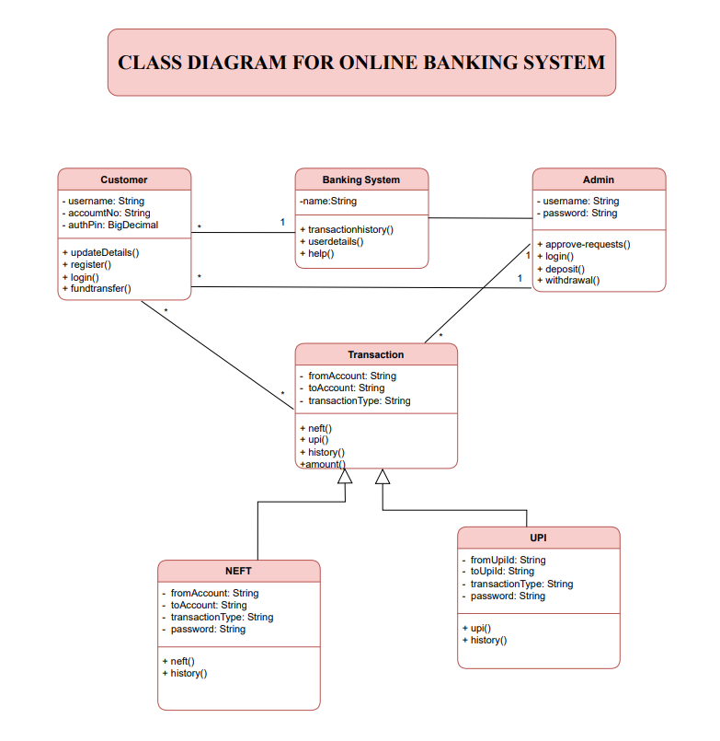
Soft Bank

Slide 11

Soft Bank
Modules
Menu
About Us
@reallygreatsite
Customer
Module
Admin
Module
Registration / Login
Login
Open Account
Approve-requests
Transaction
Withdrawal
Update Details
Deposit

Slide 12
Soft Bank
Project Screenshots

Slide 13
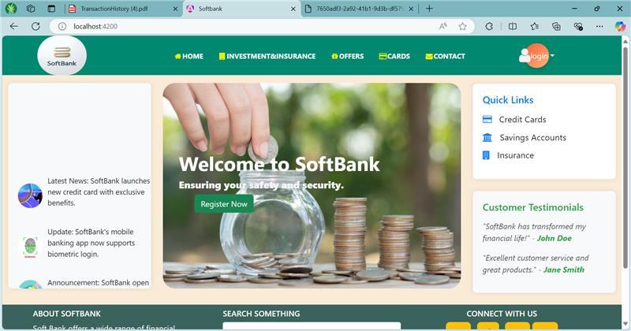
Soft Bank

Slide 14
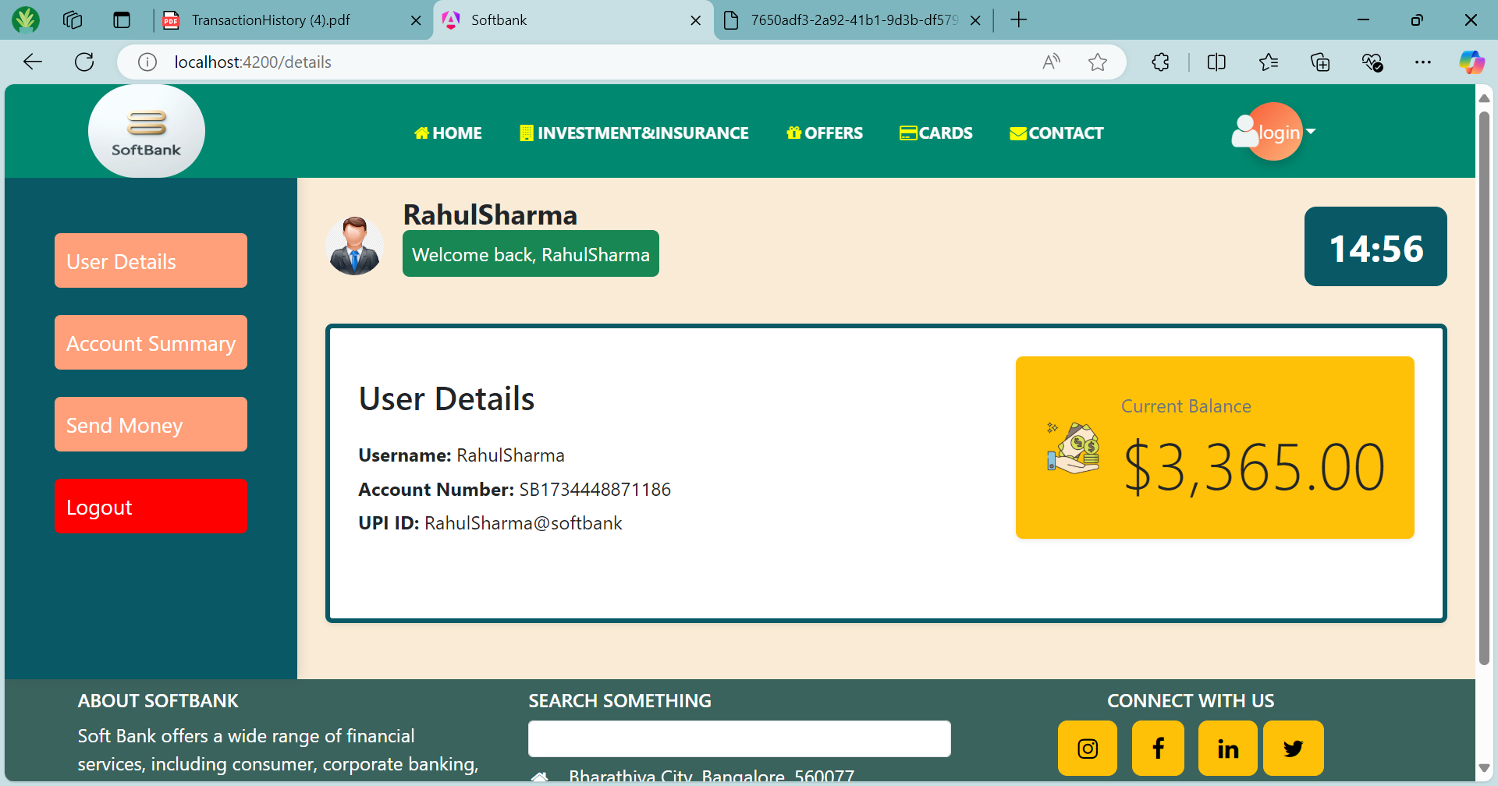
Soft Bank

Slide 15
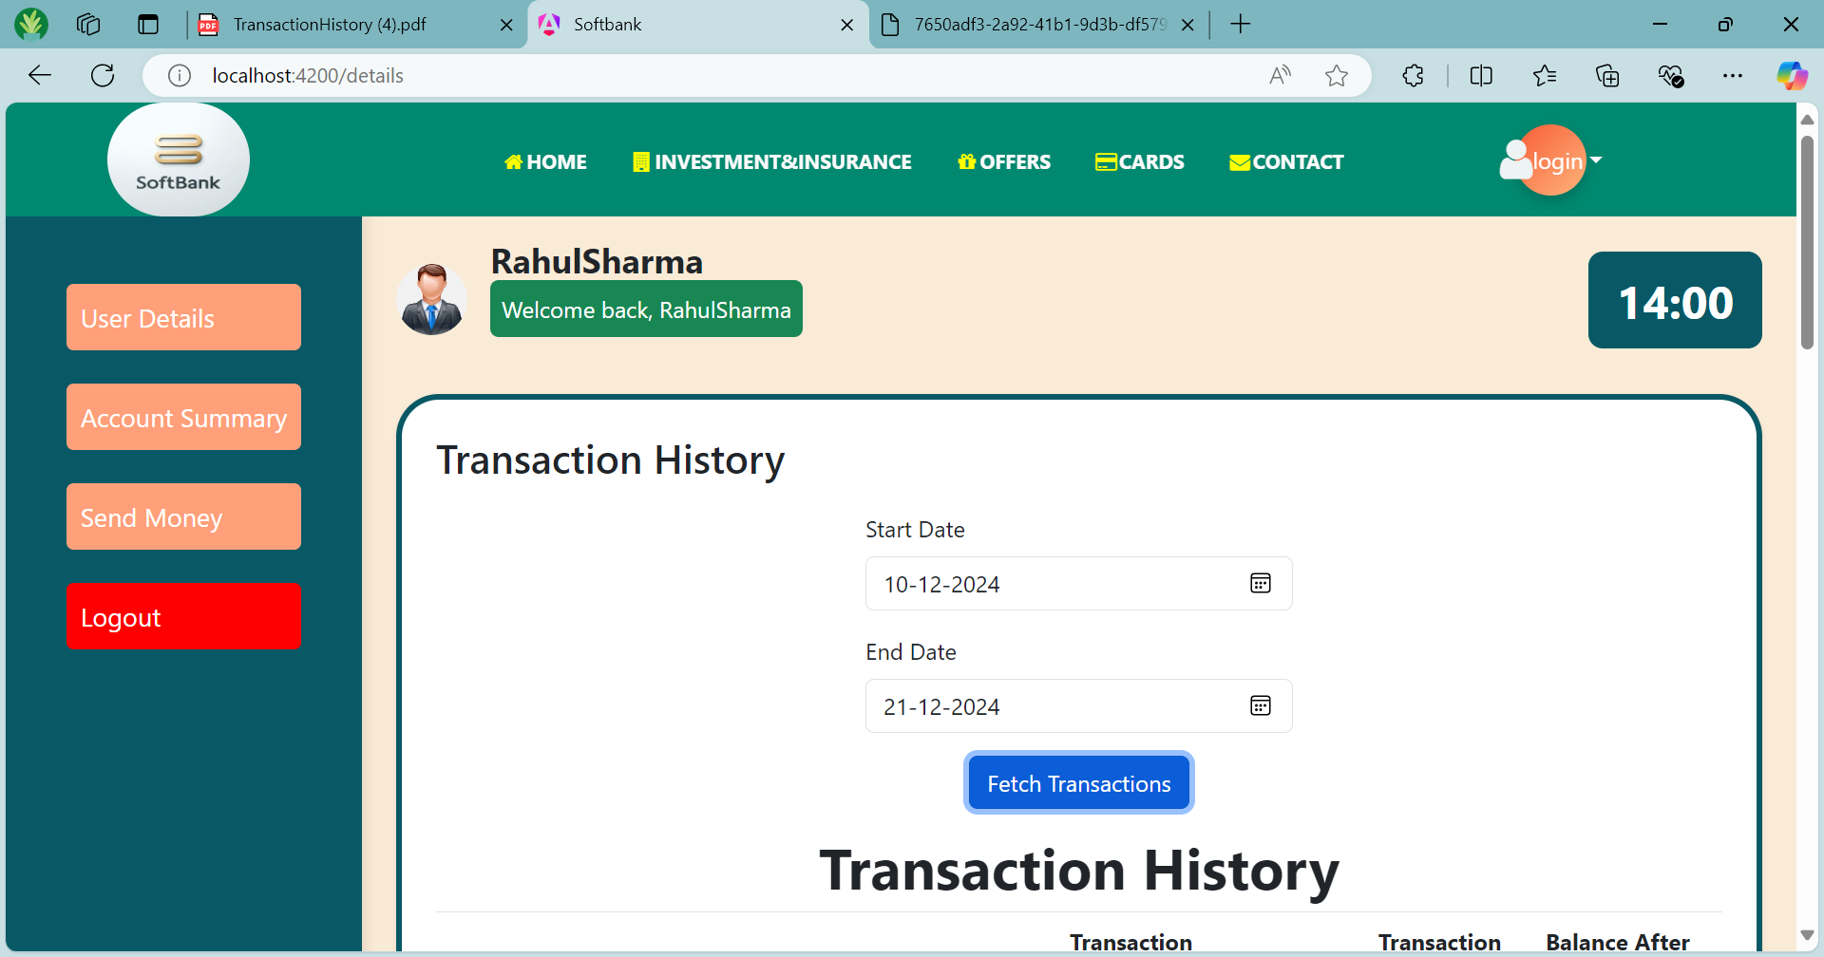
Soft Bank

Slide 16
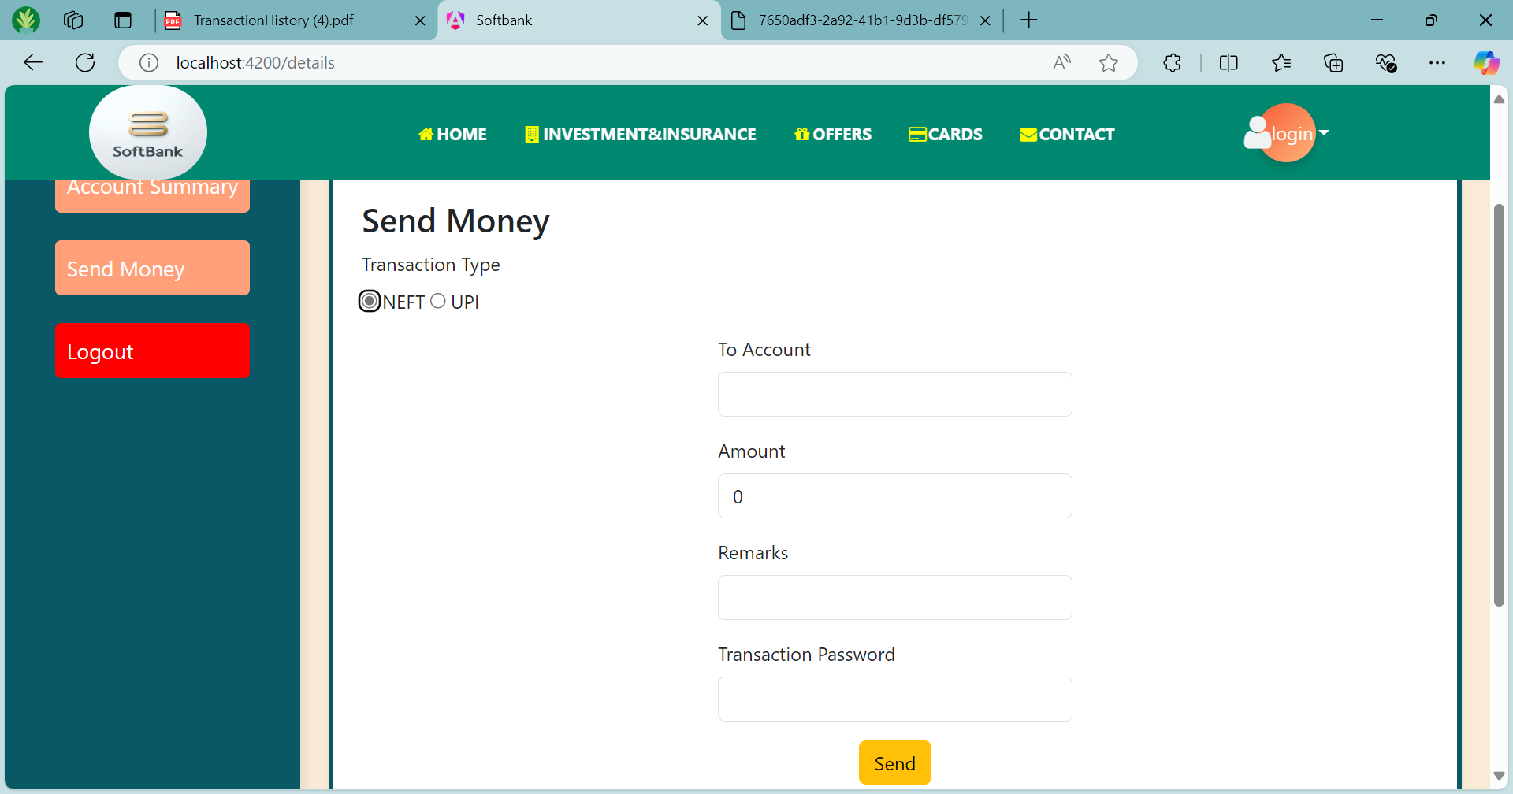
Soft Bank

Slide 17

Soft Bank

Slide 18
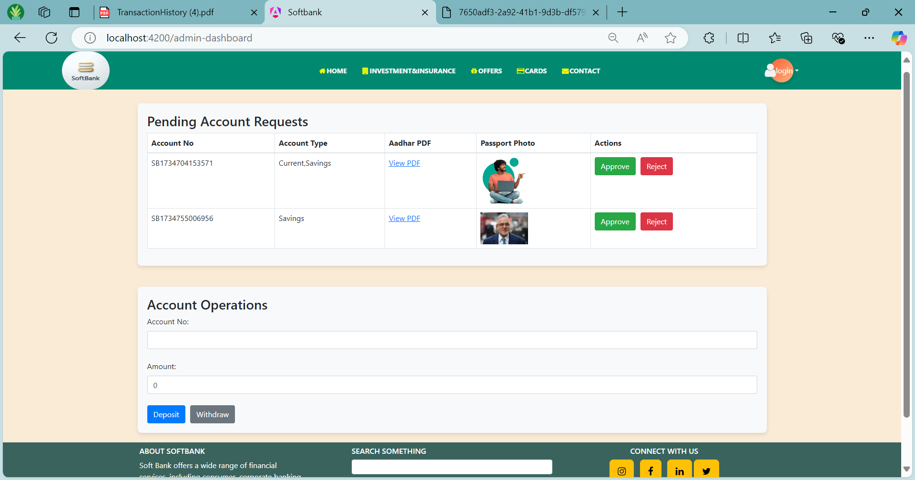
Soft Bank

Slide 19
Soft Bank
Thank you

